Slide 1

Strategic foresight APPENDIX: Cybersecurity scenario tools 2035 Traficom’s Technology and Strategy unit

Slide 2
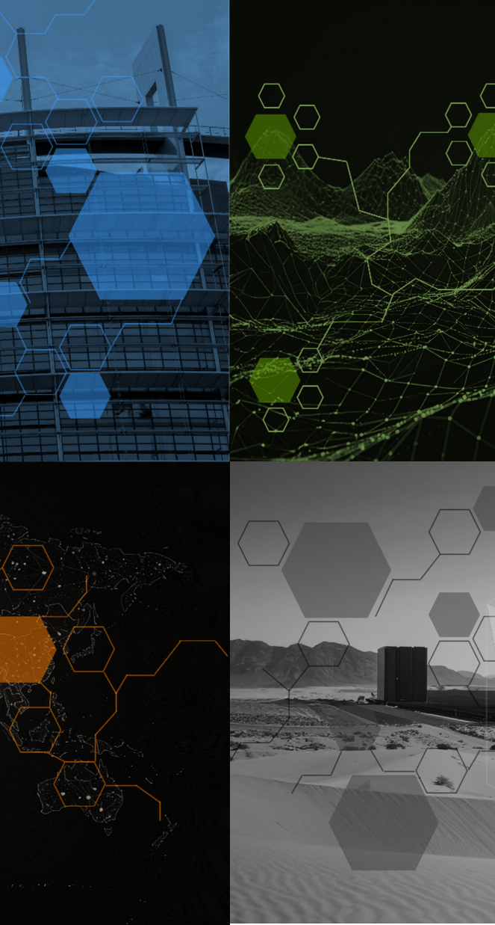
Scenario tools for proactive preparedness
The cybersecurity scenarios 2035 were built to anticipate significant cybersecurity phenomena of the future. The scenarios can be used to create futures-oriented preparedness plans or carry out proactive training.
Even at their best, scenarios can only describe a limited number of developments in the operating environment. The best way to optimise the benefits of the scenarios for preparedness is to immerse yourself in their worlds and translate their ‘general’ worlds into the real-life context of your specific sector and organisation. On the following pages, you can find frameworks for positioning your organisation in possible future worlds.
Templates for futures-oriented threat modelling are also included. What vulnerabilities will the future operating environment and technologies create? Which new opportunities does the scenario offer defenders and, on the other hand, threat actors?

Slide 3
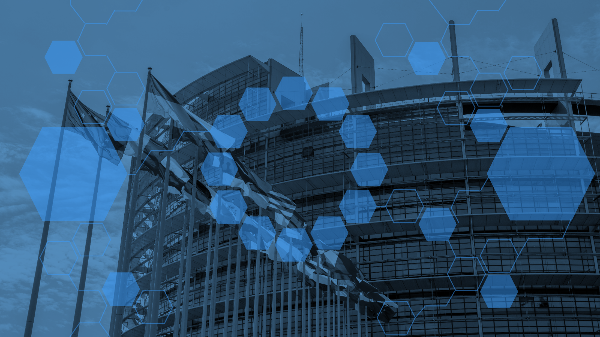
/TORCHBEARER/
Tools for describing your organisation and threat models in the scenario for 2035

Slide 4
Scenario 1 – Torchbearer – Template for describing your organisation in the scenario for 2035
Description of the organisation in the scenario for 2035
Data resources | Systems | Supply chain and dependencies | Staff
What has changed? How has technological development affected the subject area? How has regulation affected the subject area? What impact has the cyber environment had? | What has changed? How has technological development affected the subject area? How has regulation affected the subject area? What impact has the cyber environment had? | What has changed? How has technological development affected the subject area? How has regulation affected the subject area? What impact has the cyber environment had? | What has changed? How has technological development affected the subject area? How has regulation affected the subject area? What impact has the cyber environment had?
Identity and access control | Architecture | Situational awareness | Asset management
What has changed? How has technological development affected the subject area? How has regulation affected the subject area? What impact has the cyber environment had? | What has changed? How has technological development affected the subject area? How has regulation affected the subject area? What impact has the cyber environment had? | What has changed? How has technological development affected the subject area? How has regulation affected the subject area? What impact has the cyber environment had? | What has changed? How has technological development affected the subject area? How has regulation affected the subject area? What impact has the cyber environment had?
/TORCHBEARER/

Slide 5
Scenario 1 – Torchbearer – Template for describing the cyber threat model in the scenario for 2035
Description of the cyber threat in the scenario for 2035
Cyber threat |  | Defence/preparedness
Description of attacker | Attack enablers | Description of defender | Enablers of defence
Description of attacker Attacker’s motivation Targeted benefit | Competence Systems and technology Partners and networks | Position of the defending party in the scenario | Competence Systems and technology Partners and networks
Description of the threat/attack |  | Defender’s actions
Exploited/triggered weakness Technologies and systems used Description of action MITRE ATT&CK type |  | Organisation of defence Technologies and systems used Reliance on partners
/TORCHBEARER/

Slide 6
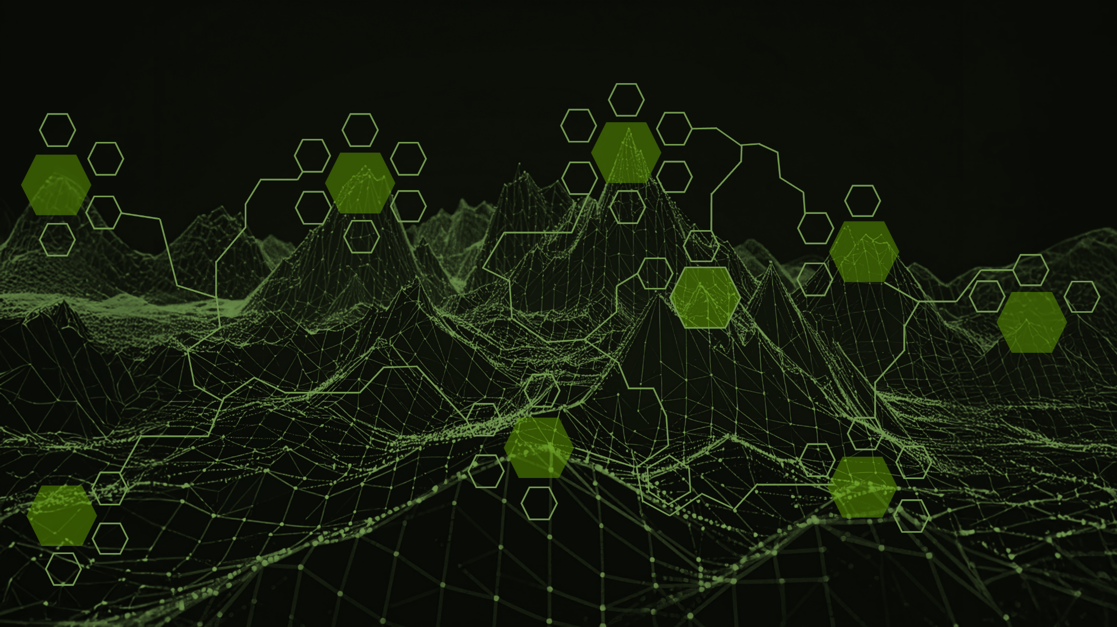
/FRAGMENTATION/
Tools for describing your organisation and threat models in the scenario for 2035

Slide 7
Scenario 2 – Fragmentation – Template for describing your organisation in the scenario for 2035
Description of the organisation in the scenario for 2035
Data resources | Systems | Supply chain and dependencies | Staff
What has changed? How has technological development affected the subject area? How has regulation affected the subject area? What impact has the cyber environment had? | What has changed? How has technological development affected the subject area? How has regulation affected the subject area? What impact has the cyber environment had? | What has changed? How has technological development affected the subject area? How has regulation affected the subject area? What impact has the cyber environment had? | What has changed? How has technological development affected the subject area? How has regulation affected the subject area? What impact has the cyber environment had?
Identity and access control | Architecture | Situational awareness | Asset management
What has changed? How has technological development affected the subject area? How has regulation affected the subject area? What impact has the cyber environment had? | What has changed? How has technological development affected the subject area? How has regulation affected the subject area? What impact has the cyber environment had? | What has changed? How has technological development affected the subject area? How has regulation affected the subject area? What impact has the cyber environment had? | What has changed? How has technological development affected the subject area? How has regulation affected the subject area? What impact has the cyber environment had?
/FRAGMENTATION/

Slide 8
Scenario 2 – Fragmentation – Template for describing the cyber threat model in the scenario for 2035
Description of the cyber threat in the scenario for 2035
Cyber threat |  | Defence/preparedness
Description of attacker | Attack enablers | Description of defender | Enablers of defence
Description of attacker Attacker’s motivation Targeted benefit | Competence Systems and technology Partners and networks | Position of the defending party in the scenario | Competence Systems and technology Partners and networks
Description of the threat/attack |  | Defender’s actions
Exploited/triggered weakness Technologies and systems used Description of action MITRE ATT&CK type |  | Organisation of defence Technologies and systems used Reliance on partners
/FRAGMENTATION/

Slide 9
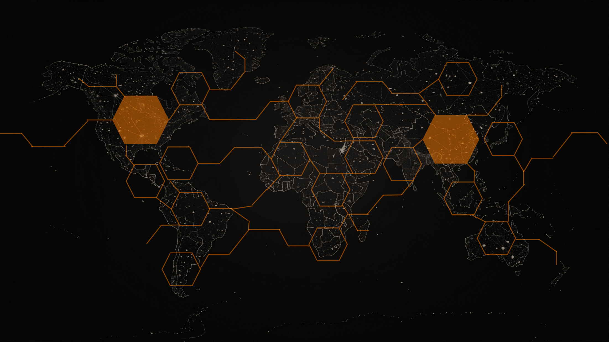
/TWO REALMS/
Tools for describing your organisation and threat models in the scenario for 2035

Slide 10
Scenario 3 – Two realms – Template for describing your organisation in the scenario for 2035
Description of the organisation in the scenario for 2035
Data resources | Systems | Supply chain and dependencies | Staff
What has changed? How has technological development affected the subject area? How has regulation affected the subject area? What impact has the cyber environment had? | What has changed? How has technological development affected the subject area? How has regulation affected the subject area? What impact has the cyber environment had? | What has changed? How has technological development affected the subject area? How has regulation affected the subject area? What impact has the cyber environment had? | What has changed? How has technological development affected the subject area? How has regulation affected the subject area? What impact has the cyber environment had?
Identity and access control | Architecture | Situational awareness | Asset management
What has changed? How has technological development affected the subject area? How has regulation affected the subject area? What impact has the cyber environment had? | What has changed? How has technological development affected the subject area? How has regulation affected the subject area? What impact has the cyber environment had? | What has changed? How has technological development affected the subject area? How has regulation affected the subject area? What impact has the cyber environment had? | What has changed? How has technological development affected the subject area? How has regulation affected the subject area? What impact has the cyber environment had?
/TWO REALMS/

Slide 11
Scenario 3 – Two realms – Template for describing the cyber threat model in the scenario for 2035
Description of the cyber threat in the scenario for 2035
Cyber threat |  | Defence
Description of attacker | Attack enablers | Description of defender | Enablers of defence
Description of attacker Attacker’s motivation Targeted benefit | Competence Systems and technology Partners and networks | Position of the defending party in the scenario | Competence Systems and technology Partners and networks
Description of the threat/attack |  | Defender’s actions
Exploited/triggered weakness Technologies and systems used Description of action MITRE ATT&CK type |  | Organisation of defence Technologies and systems used Reliance on partners
/TWO REALMS/

Slide 12
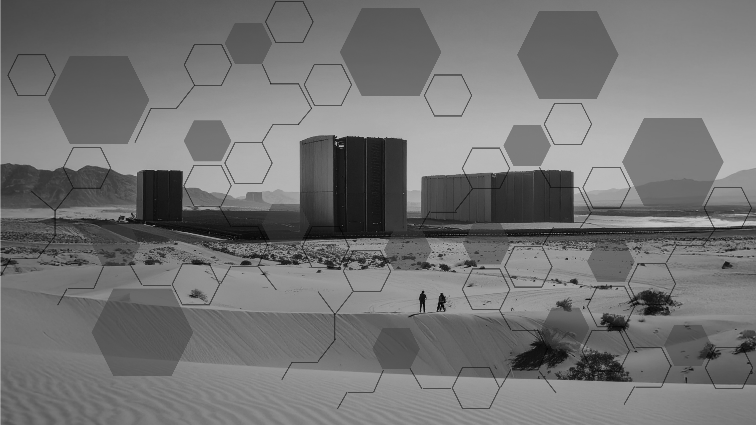
/DATA EMPIRES/
Tools for describing your organisation and threat models in the scenario for 2035

Slide 13
Scenario 4 – Data empires – Template for describing your organisation in the scenario for 2035
Description of the organisation in the scenario for 2035
Data resources | Systems | Supply chain and dependencies | Staff
What has changed? How has technological development affected the subject area? How has regulation affected the subject area? What impact has the cyber environment had? | What has changed? How has technological development affected the subject area? How has regulation affected the subject area? What impact has the cyber environment had? | What has changed? How has technological development affected the subject area? How has regulation affected the subject area? What impact has the cyber environment had? | What has changed? How has technological development affected the subject area? How has regulation affected the subject area? What impact has the cyber environment had?
Identity and access control | Architecture | Situational awareness | Asset management
What has changed? How has technological development affected the subject area? How has regulation affected the subject area? What impact has the cyber environment had? | What has changed? How has technological development affected the subject area? How has regulation affected the subject area? What impact has the cyber environment had? | What has changed? How has technological development affected the subject area? How has regulation affected the subject area? What impact has the cyber environment had? | What has changed? How has technological development affected the subject area? How has regulation affected the subject area? What impact has the cyber environment had?
/DATA EMPIRES/

Slide 14
Scenario 4 – Data empires – Template for describing the cyber threat model in the scenario for 2035
Description of the cyber threat in the scenario for 2035
Cyber threat |  | Defence
Description of attacker | Attack enablers | Description of defender | Enablers of defence
Description of attacker Attacker’s motivation Targeted benefit | Competence Systems and technology Partners and networks | Position of the defending party in the scenario | Competence Systems and technology Partners and networks
Description of the threat/attack |  | Defender’s actions
Exploited/triggered weakness Technologies and systems used Description of action MITRE ATT&CK type |  | Organisation of defence Technologies and systems used Reliance on partners
/DATA EMPIRES/

Slide 15
If one can imagine it, one can prepare for it.
Traficom’s Technology and Strategy unit
ennakointi@traficom.fi
Kirsi Karlamaa, Director of Technology and Strategy
Aleksi Blomqvist, Senior Specialist
Paul Hermansson, Senior Specialist
Henri Jokinen, Senior Specialist
Markus Mettälä, Senior Specialist

